Slide 1
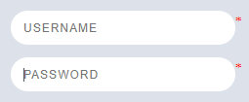
Q 1: Assumptions/ Pre conditions: Sam works at Mumbai office and his biometrics are registered in the system.
Scenario: Sam uses fingerprint biometric punching to enter Globallogic Mumbai office
Considering FURPS (Functionality, Usability, Reliability, Performance, Sustainability), write 4 -5 high level scenarios.
Q2:
a.) Write all negative possible combinations of username and password
(Positive combination – valid username & valid password)
b.) Write all possible number combinations you can think of : TWO NINE TWO ZERO

Slide 2
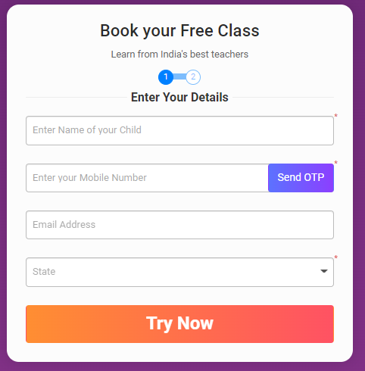
Q3: Write few high level validation scenarios: https://byjus.com/byjus-classes-book-free-60-mins-class/?utm_source=google&utm_mode=CPA&utm_campaign=K10-IN-Brand-BYJU%27S-USD-Exact&utm_term=byjus&gclid=Cj0KCQjwio6XBhCMARIsAC0u9aGgY_JNu0wSUINCHFf3RxhVetxJKvUkvC6dFL-RVD92bLTBn86LOBQaAmL1EALw_wcB

